Slide 1
Electronic supplementary material
Evaluation of polydimethylsiloxane-phenylsiloxane as a coating for stir bar sorptive extraction
Yamile Pérez-Padilla¹, Saúl Ariel Medina Cetina¹, Alejandro Ávila-Ortega¹, Jesús Alberto Barrón-Zambrano¹, Alfredo Rafael Vilchis-Néstor², Cristian Carrera-Figueiras¹, David Muñoz-Rodríguez¹*
1. Cuerpo Académico de Química Fundamental y Aplicada, Facultad de Ingeniería Química, Universidad Autónoma de Yucatán, Periférico Norte km 33.5, Tablaje Catastral 13615, Col. Chuburná de Hidalgo Inn, C.P. 97203 Mérida, YUC, México
2. Centro Conjunto de Investigación en Química Sustentable UAEM-UNAM, Carretera Toluca-Atlacomulco km 14.5, Campus “El Rosedal”, C.P. 50200 San Cayetano-Toluca, MEX, México

Slide 2
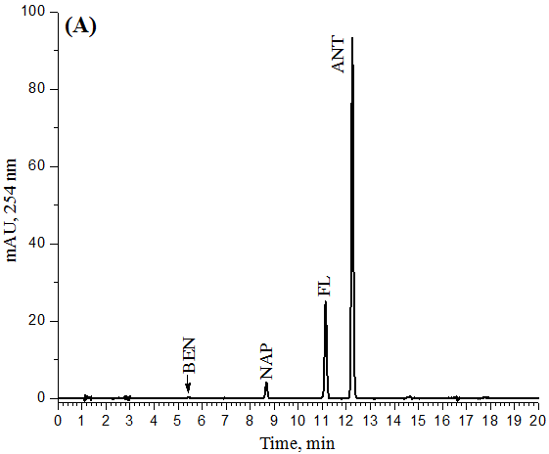
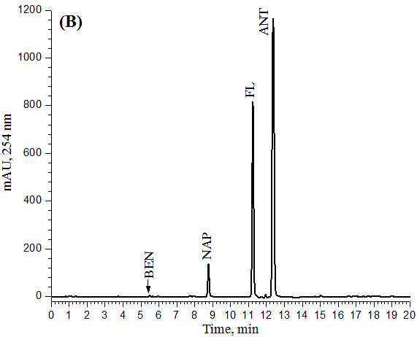
Fig. 1S Typical chromatograms of benzene derivatives. (A) Standard solution (1 ug/mL) and (B) SBSE extract

Slide 3
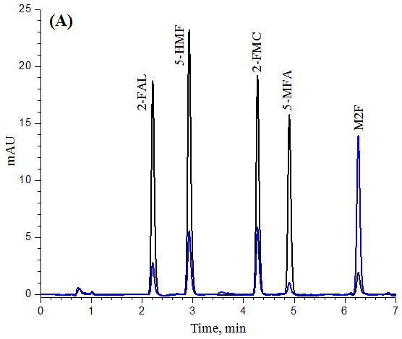
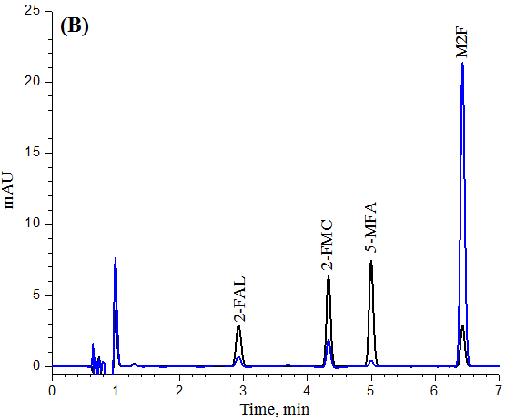
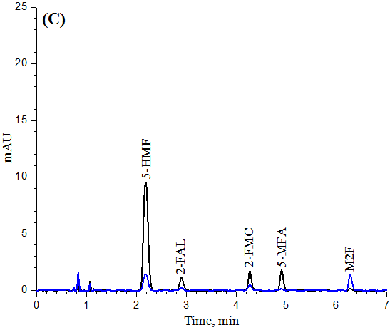
Fig. 2S Typical chromatograms of furanic derivatives. (A) Standard solution (1 ug/mL) and analytes after stir bar sorptive extraction from (B) aqueous solutions and (C) isooctane. (⎯) 278 nm, (⎯) 248 nm.

Slide 4
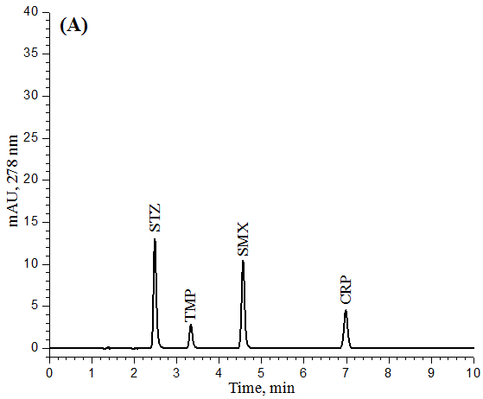
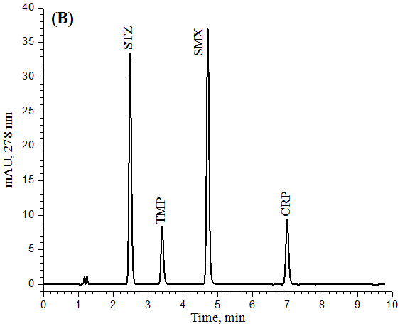
Fig. 3S Typical chromatograms of antibiotics. (A) Standard solution (1 ug/mL) and (B) analytes after stir bar sorptive extraction from isooctane.

